Slide 1



G H RAISONI INSTITUTE OF ENGINEERING AND TECHNOLOGY, NAGPUR
(Approved by AICTE, New Delhi and Recognized by DTE, Maharashtra)
An Autonomous Institute Affiliated to Rashtrasant Tukadoji Maharaj Nagpur University, Nagpur
Accredited by NAAC with A+ Grade
Department of Science and Technology
Introductory Seminar
On
URBAN SPOTTER
GUIDE:Mr.Anupam Chaube
Name of Projectees
Mr. Charanjot Singh Sivia Mr.Ayush Mandpe
Mr. Amruj Lende Mr.Amritpal Singh Bamrah
Mr. Shivam Deotale Mr. Gagan Bisen
Session 2022-23

Slide 2
Contents
Introduction
Literature Survey
Objective of Project
Block Diagram /DFD and ER Diagram
Work done
Result & Discussion
Work plan
Conclusion (Till Date)
References

Slide 3
Introduction
Introducing Urban Spotter, where seamless parking meets modern convenience.Navigating the urban jungle or event crowds has never been easier.
Our platform is your go-to destination for finding,reserving,and managing parking spaces effortlessly.
Navigate the urban landscape effortlessly with our smart parking solutions.Our user-friendly interface lets you reserve parking spaces with ease,ensuring a stress free start to your journey.
Welcome to a world where parking is no longer a hassle- welcome to Urban Spotter.

Slide 4
Literature Survey
Sr. No.----- | Paper Title and its Author | Details of Publication | Findings
1 | Journal of transport and land use and author Franziska Kirschener | June 2021 | problem of parking due to vast tansportation
2 | A smart parking prediction system based on machine learning algorithms Chien, S., Chou, C., Chen, Y., & Huang, Y | 2017 | a machine learning-based smart parking prediction system that enhances urban mobility by accurately forecasting parking space availability
3 | Journal of Traffic and transportation and engineering Sanjaykumar M. Dave, janak Parmar & Pritikana Das | February 2020 | Study on demand and characteristics of parking system in urban areas: A review
4 | Smart parking system: comprehensive review based on various aspect Abrar Fahim, Mehedi Hasan & Muhtasim Alam Chowdhury | May 2021 | The proliferation of urbanization and the increasing number of vehicles on roads have significantly amplified parking-related issues globally.

Slide 5
Literature Survey
Sr. No.----- | Paper Title and its Author | Details of Publication | Findings
5 | Smart Parking Managment System Amol Pomaji, Suraj Boinwad & Pushpendar Singh | May 2019 | If this is a recent development or a specific project you're interested in, I would recommend searching academic databases, university repositories, or online research platforms for any publications or reports authored by these individuals on the topic of smart parking management systems.
6 | The Issue of addresing the lack of parking pace for road freight transport in cities Jan Lizbetin & Ladislav Bartuska | March 2020 | Research on this topic typically focuses on identifying the causes of the parking space shortage, assessing its impact on urban congestion, pollution, and economic efficiency, and proposing potential solutions or mitigation strategies.

Slide 6
Objectives
Simplify the parking experience by providing a straightforward and user-friendly platform.
Reduce the time and stress associated with finding parking spaces.
Focus on user satisfaction by ensuring cost structures,secure reservations, and a platform that incorporates user feedback.
Our goal is to provide accessible parking options, including features for individuals with specific requirements,ensuring convenience for all user.
Our objective is to transform the way people perceive and interact with parking spaces in urban areas, making parking more efficient, convenient, and sustainable for all stakeholders involved.

Slide 7
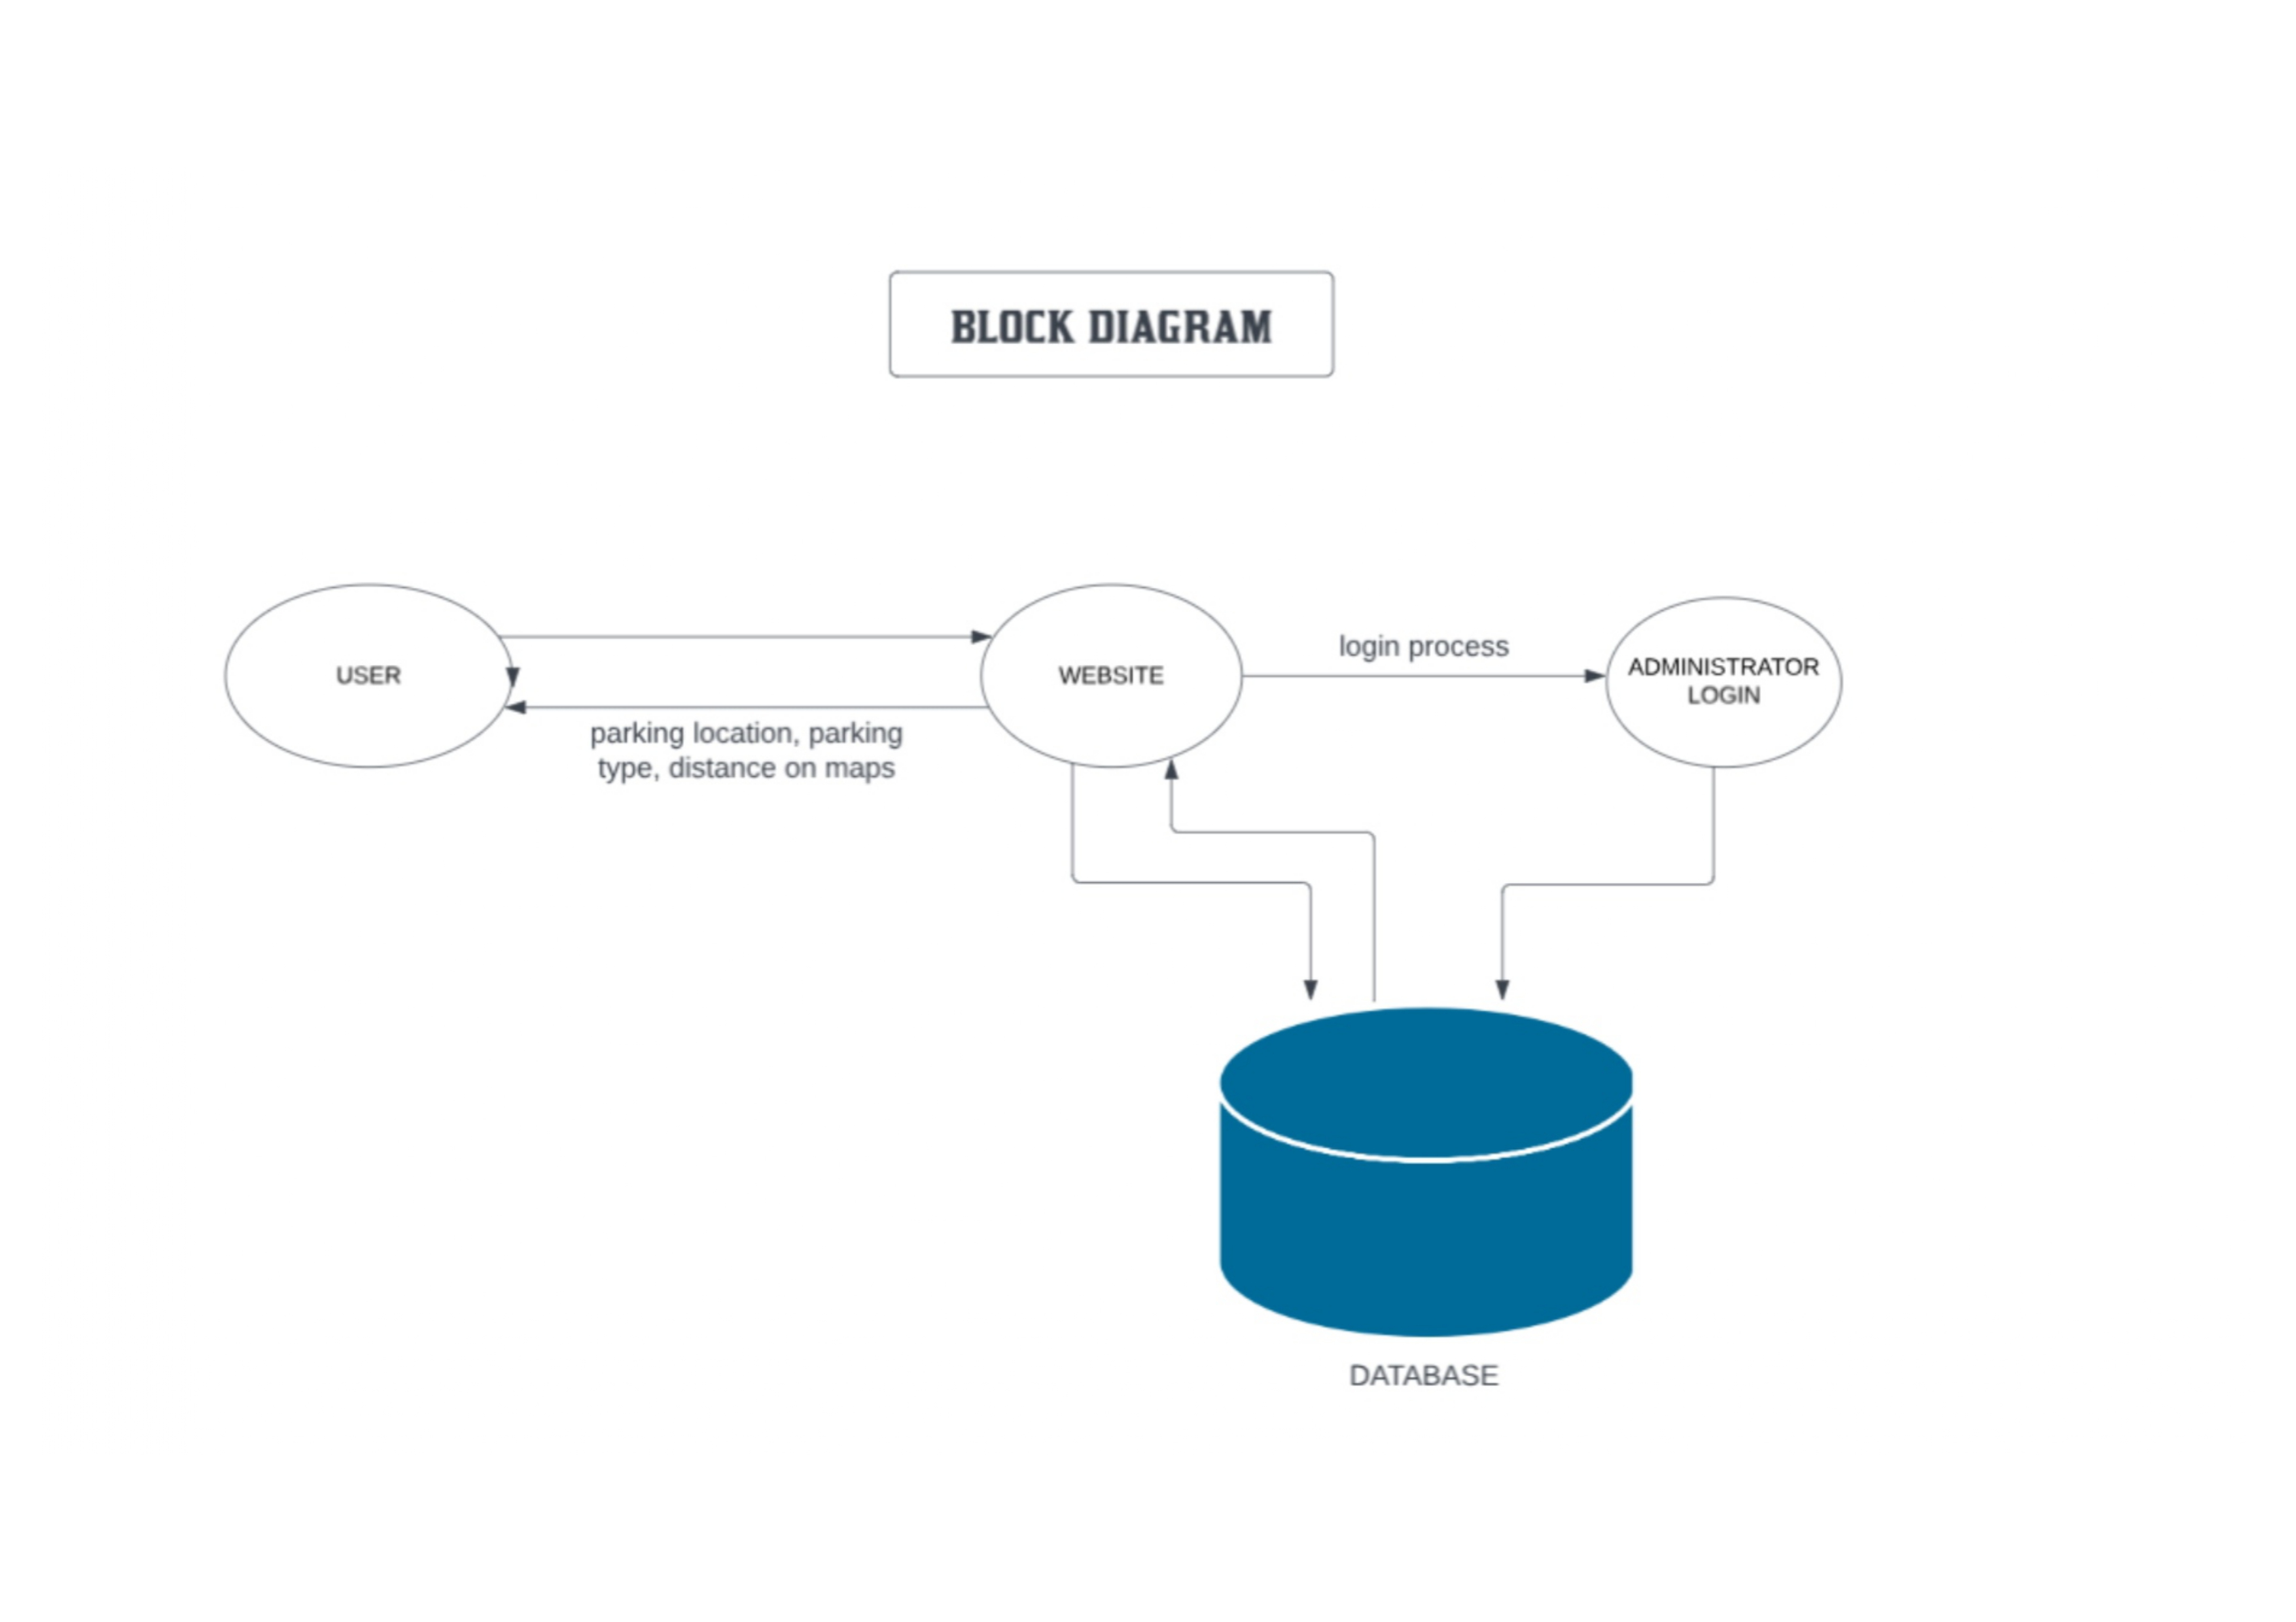
Block Diagram
Fig. 1 NAME OF FIGURE

Slide 8
Work done
Decided the work for projectees and given the work to the individuals according to their roles.
Discussed the problems that are being faced by the people in order to park their vehicles.
Planned the sequence of attributes in the website which makes it more convenient to use.
Started with the front end work.
The website is being designed in such a Structure that it can be used easily without getting confused.

Slide 9
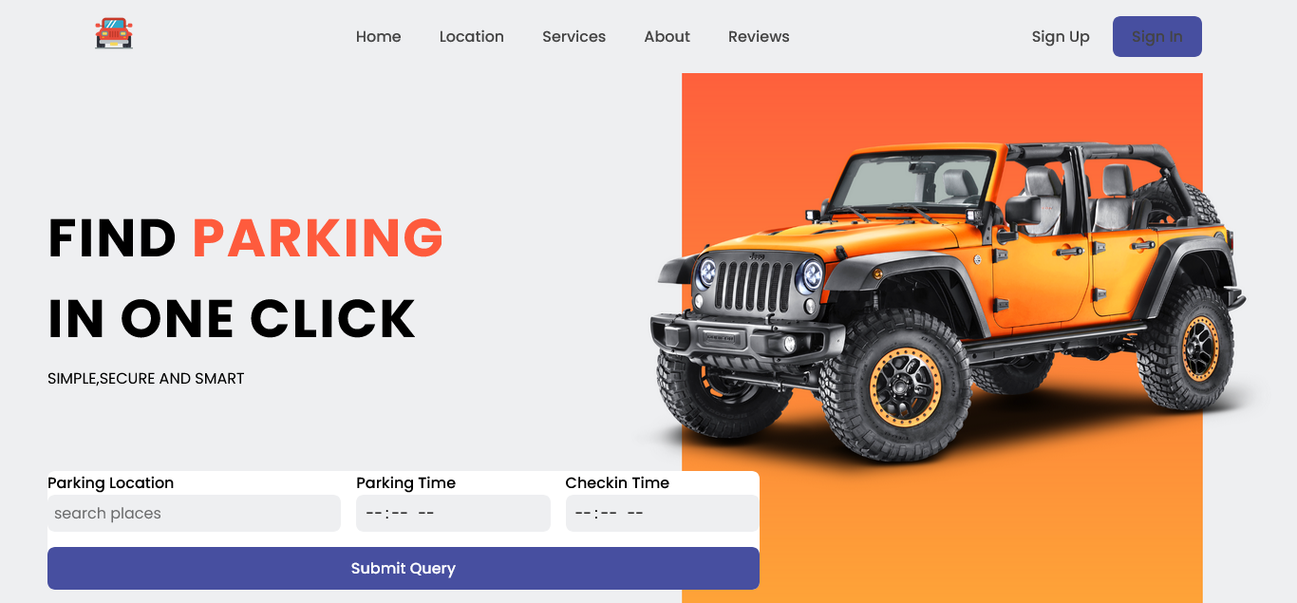
Work done
HomePage

Slide 10
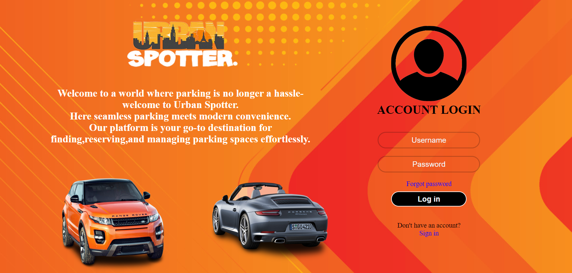
Work done
Login page

Slide 11
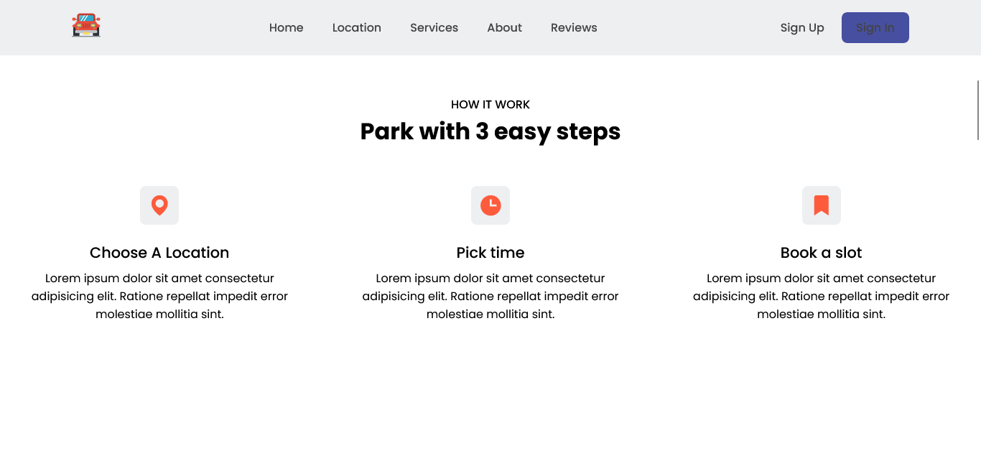
Work done

Slide 12
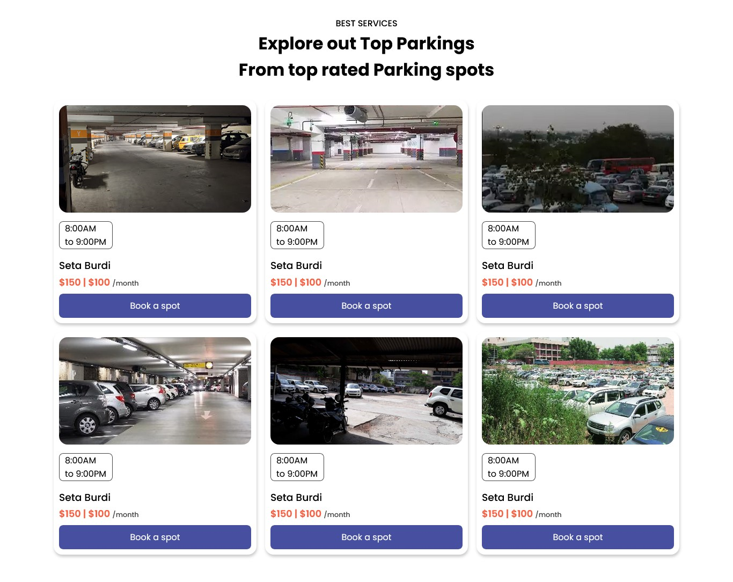
Work done

Slide 13
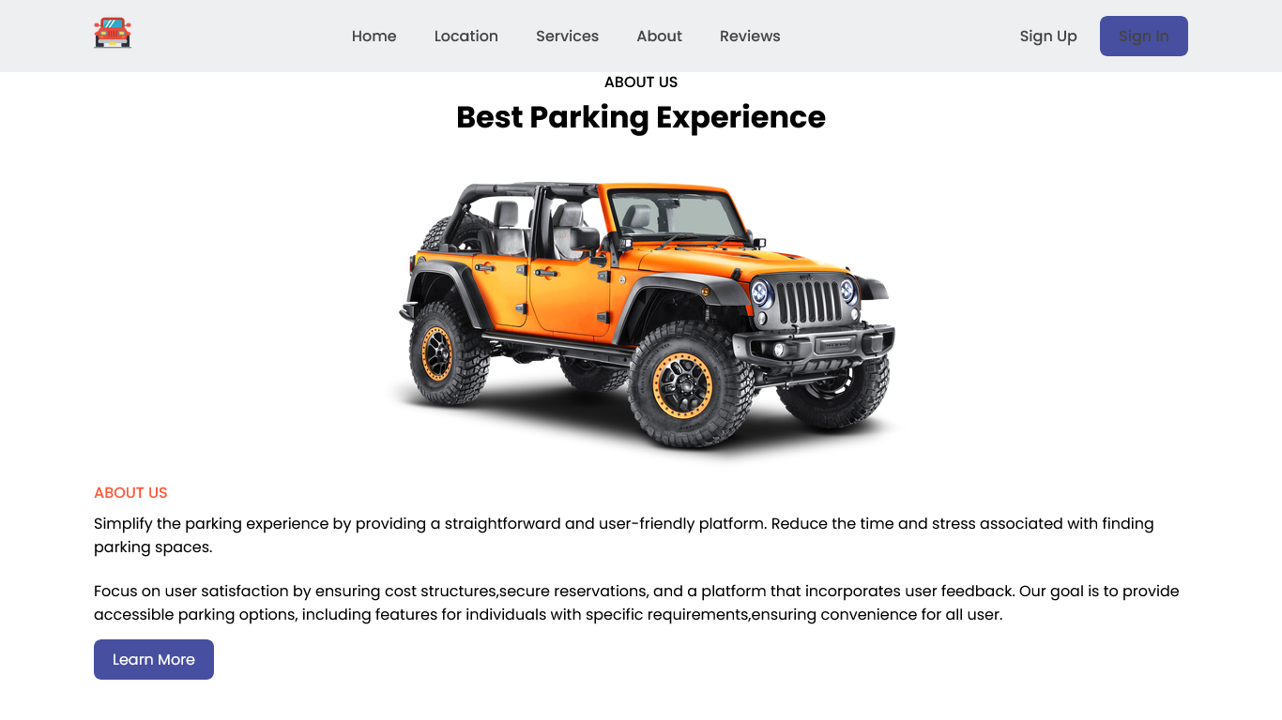
Work done

Slide 14

Work done

Slide 15
Result & Discussion
Discussed about the problems which is faced by many of the people while parking their vehicle.
Discussed about database for keeping each and every details of the user secure in the website.
Discussed about the linking of database with the website.
Evaluating the accuracy of parking recommendations provided by Urban Spotter by comparing them with real-world experiences and user feedback.
Assessing the level of community contribution through the administration portal by tracking the number of new parking areas added by users.
Gathering feedback from users through surveys, reviews, and ratings to measure their satisfaction and overall experience with Urban Spotter.

Slide 16
Work – Plan
Months Activities | JAN’23 | FEB’23 | MAR’23 | APR’23
Project Reviews | √ | √
Component Identification & Selection |  | √ | √
Designing |  | √ | √
coding |  | √ | √
Experimental Analysis
Testing and Debugging
Preparation of Project Report
Thesis and Poster Submission

Slide 17
Conclusion (Till Date)
Urban Spotter aims to revolutionize the parking experience by providing a user-friendly platform that simplifiesnthe process of finding and reserving parking spaces.Through the integration of advanced technology,transparent cost structure,and user driven feedback,we strive to offer a seamless and efficient solution for users seeking convenient and stress-free parking.Urban Spotter aspires to redefine the way individuals approach and experience parking,making it a positive and integral part of their journey.Join us on this journey towards a future where parking is not just a necessity but a hassle-free and enjoyable experience.

Slide 18
References
Dribble:
https://dribbble.com/
parking.com:
https://parking.com
We used parking.com for database and design UI.
Secureparking:
https://www.secureparking.co.in
We used this website for same reference and discovered more detailed information to put in our website.

Slide 19
Thank you !

